Slide 1

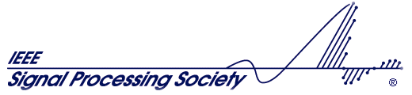
Things We Should Not Do In Future Radios
(Future Designs Should Not Include Past Mistakes)
fred harris
San Diego IEEE
4-December 2018

Slide 2
Topic
Future Technologies and Applications
Title
Things We Should Not Do In Future Radios
(Future Designs Should Not Include Past Mistakes)
Wireless technology is a shining example of a disruptive innovation that has changed society in remarkable ways. The innovation has altered how people communicate, how people access information, how people are entertained, and how people conduct and schedule their social lives. Every human activity advances and grows through a number of influences. One is experience, one is market forces, another is effective education, and yet another is common wisdom. Common wisdom is entrenched perspectives and levels of understanding accepted by the community as guide posts of the process. In fact there are many examples to be found in the wireless community of common wisdom being faulty. Samuel Clemens’ comment “It ain’t what you don’t know that gets you in trouble, it’s what you know for sure that just ain’t so” The wireless community is not free of entrenched faulty common wisdom which is passed on to successive practitioners of the art. Universities are just as liable as industry for not examining and questioning common wisdom. In this presentation we examine the evolution of wireless technology from the early days through now and show how a number of wisdoms can be shown to not be wise but never-the-less have become entrenched in the fabric of our wireless technology

Slide 3
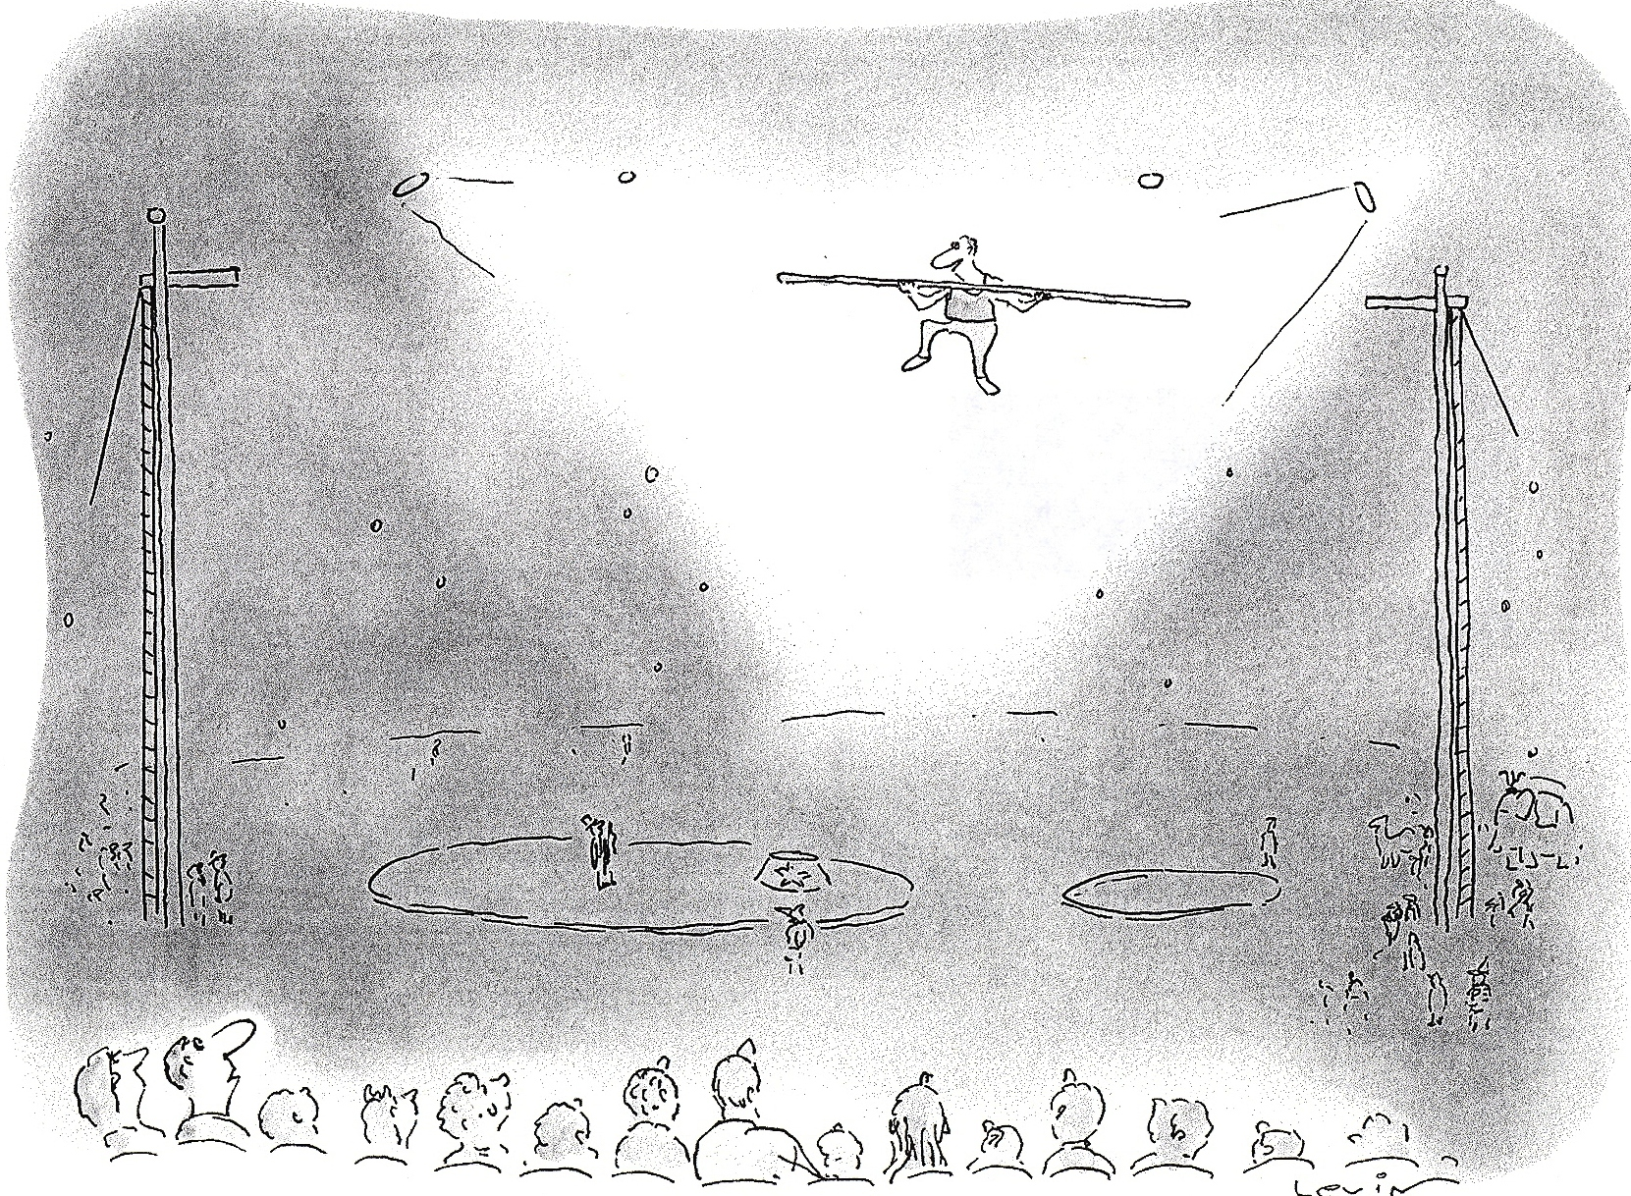

Slide 4
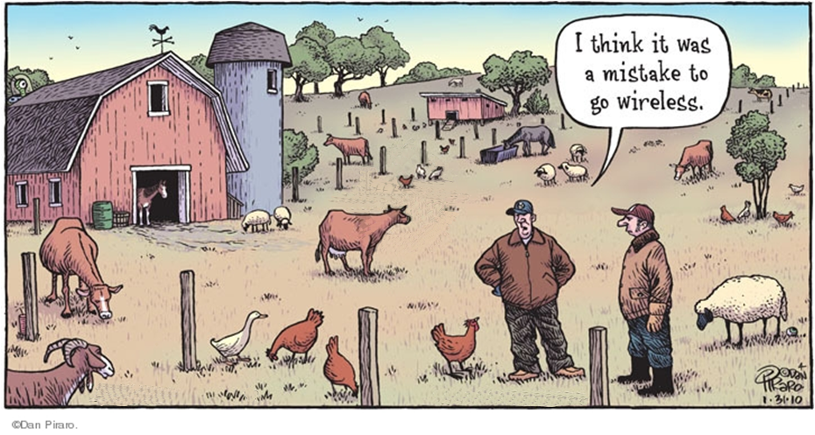

Slide 5
What The Customer Wants
New Yorker Magazine

Slide 6
What The Customer Expects to Pay
New Yorker Magazine

Slide 7
When The Customer Wants it
New Yorker Magazine

Slide 8
What Size Customer Wants
Standard Market Drivers
Enabling Technology
Cost
Time to Market
Size, Weight and Power
New Yorker Magazine

Slide 9
Why Digital Communications?
But Let Your Communications Be Yea, Yea: Nay, Nay:
For What So Ever is More Than These Cometh of Evil.
Sermon on the Mount, Matthew, Ch. 5, verse. 37
8

Slide 10
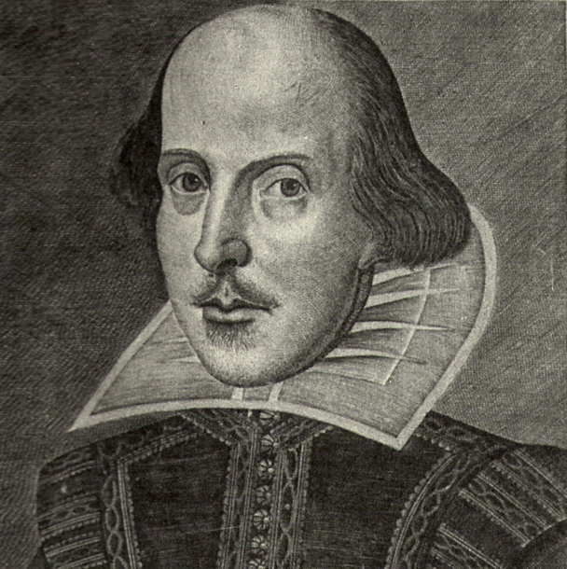
To Paraphrase the Great Bard
The World is an Analog Stage
In Which Digital
Plays A Bit Part
9

Slide 11
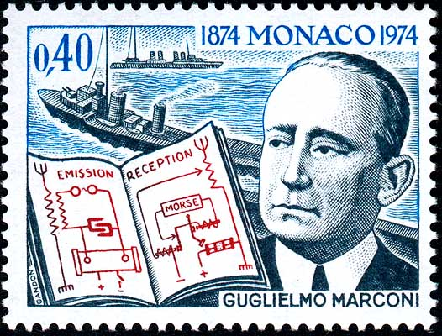
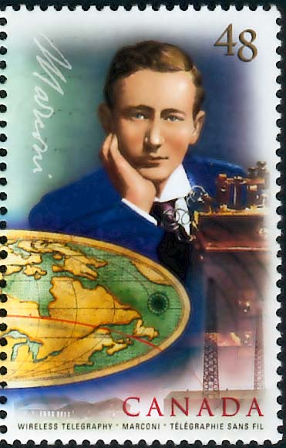
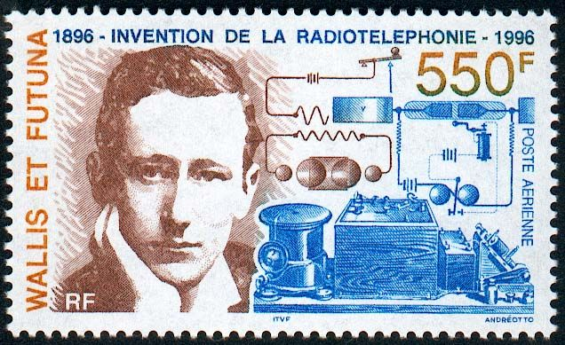
Inventor of Radio Guglielmo Marconi
Imagine that,
schematics
on a postage stamp
Sent Wireless signals Across English Channel in 1899,
Received letter “S” (. . .) sent from Newfoundland to England 1901

Slide 12
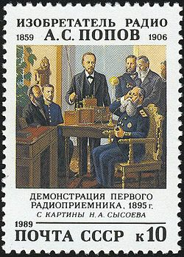
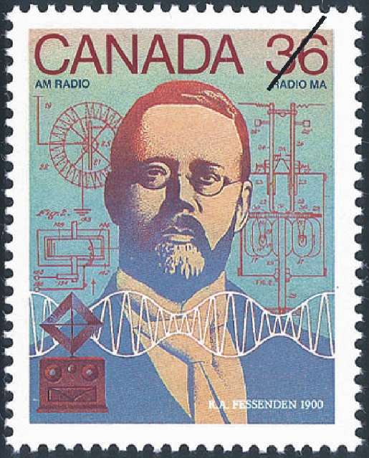
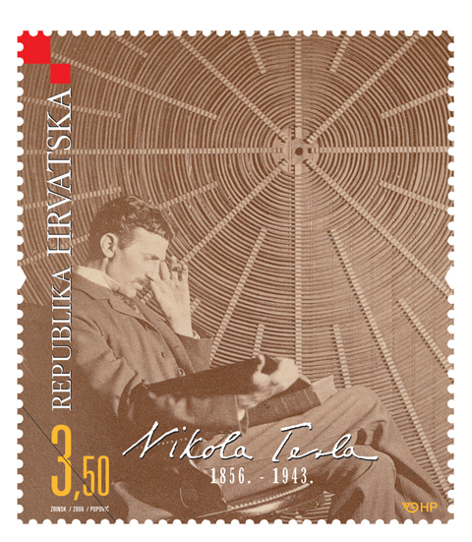
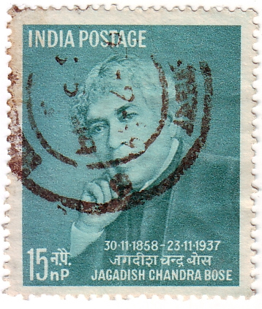
16 March 1859 -3 December 1906
6 October 1866 – 22 July 1932
10 July 1856 – 7 January 1943
30 November 1858 – 23 November 1937
Inventor of radio
Alexander Popov
on the 1989 USSR stamp.
Inventor of radio
Reginald Fessenden
on the 2000 Canada stamp.
Inventor of radio
Nikola Tesla
on the 2009 Croatia stamp.
Inventor of radio
Jagadish Chandra Bose
on the 1958 India stamp.
In 1900 a radio station was
established under Popov’s
instructions on Hogland island
Tesla’s 1900 Radio Patent was overturned in 1904 in favor of Marconi’s Radio Patent. In 1943, Shortly after his Death, the US Supreme court upheld Tesla’s
original patent and his claim as first inventor of tunable Radio Receivers.
Bose’s 1904 US Patent described
Galena Crystal Detector for
Demodulating Continuous Wave
Radio Signals. He is acknowledged
as inventor of Mercury Auto Coherer
used in Marconi’s Wireless Receiver.
Christmas Eve and New Year’s 1906
Fessenden Broadcast short speech and
Handel’s Largo and a Violin solo of
O, Holy Night, from a radio station
at Brant Rock, Mass.

Slide 13
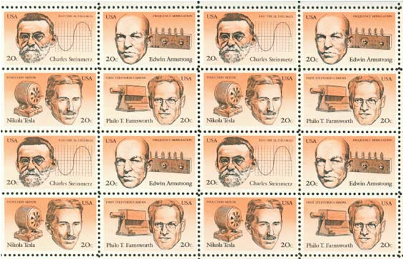
Charles Steinmetz: Alternating Current, Phasors
Nikola Tesla: Alternating Current, Induction Motor
Philo Farnsworth: Electronic Line Scanning Television
Edwin Armstrong: Oscillator, Regenerative Radio, Super-Heterodyne Radio, FM Radio
USA” Four American Inventors” 1983 Commemorative Stamp Set

Slide 14
Marine Spark Transmitter
Navies were quick to adapt radio for communication with ships at Sea
Radio Operators
Aboard Ship
Were Called
Sparky
Because they
Operated the
Spark Transmitter

Slide 15
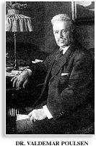
Valdemar Poulsen, 1869-1942
Replace Sparks with an Arc
Positive Resistance Absorbs Energy from Resonant Circuit
Negative Resistance Delivers Energy to Resonant Circuit
Invented in 1902 by the Danish engineer Valdemar Poulsen, The arc transmitter, unlike the spark transmitter, generated continuous radio waves.

Slide 16
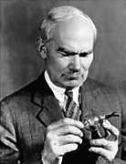
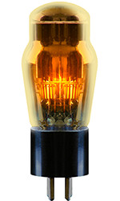
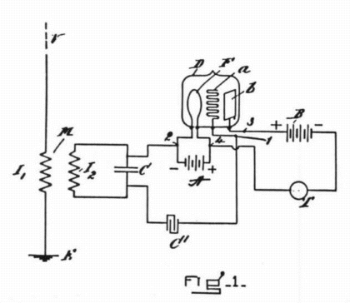
Lee De Forest,1877-1961
Thermionic Vacuum Tubes
One Element: Light Bulb, Visible Light
Two Element: Diode, Detector, (Edison Effect)
Three Element: Triode, Oscillator, Amplifier, Valve
Four Element: Tetrode, High Frequency Amplifier
Five Element: Pentode, Linear Gain HF Amplifier
US Patent No. 879532
Warm
Light Emitting
Valve
Univac, First Commercial Computer used 5000 vacuum Tubes

Slide 17
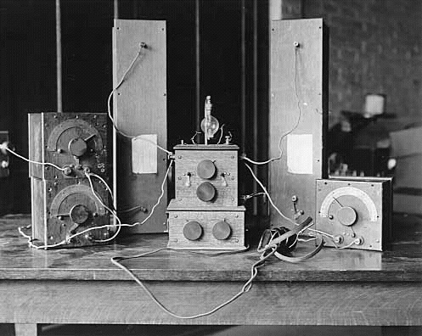
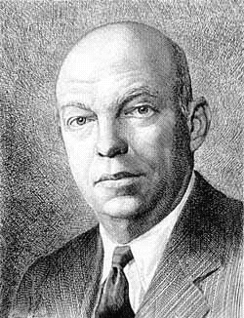
Edwin Armstrong, 1890-1954
1912 feedback (regenerative) receiver

Slide 18
Regenerative Receiver
A little Feedback Goes a Long Way

Slide 19
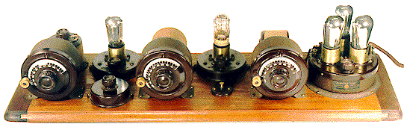
TRF: Tuned Radio Frequency Receiver
Bread Board

Slide 20
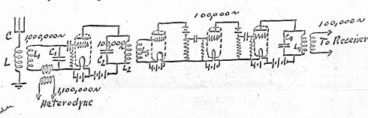
Super-Heterodyne Receiver
Edwin Armstrong’s Super-Heterodyne Patent
From Disclosure: June 3, 1918

Slide 21
Radio During the World War: (1914-1919)
Vacuum Tube Equipment Revolutionized Radio
All Amateur and Commercial Radio Activity Ceased on 7-April 1917 when US entered War
Illegal for private citizens to posses a radio Transmitter or Receiver.
US Navy Purchased Nearly All Commercial Radio Companies in US to Avoid Foreign Control
Congress was unhappy with ownership of US commercial stations.

Slide 22
US Navy Sponsored Radio Cartel
Compromise: New American Controlled Cartel formed to acquire assets of commercial stations and radio manufacturing industry:
Partners: AT&T 10.3%
General Electric 30.1%
Westinghouse 20.6%
United Fruit 4.1%
American Marconi 34.9%
Radio Corporation of America (RCA)

Slide 23
Application Evolution
Wired Telegraphy:
Symmetrical Point to Point
Wireless Telegraphy (First use of Radio):
Unsymmetrical Point to Multipoint
No Precedence!
Borrowed agriculture term!
Broadcasting (spreading of seeds)

Slide 24
Commercial Broadcasting
David Sarnoff: RCA General Manager 1921 & VP 1922
RCA formed National Broadcasting Corporation (NBC) to promote Radio (1926) and develop market to sell Radios.
Columbia Broadcasting System (CBS) formed (1928) to Compete with NBC.
NBC operated parallel Networks designated Red and Blue.
FCC, Created in 1934, in a 6-year battle forced NBC to divest one of its two Networks in 1943
Blue Network was sold in 1943 and in 1945 it became
The American Broadcasting Company (ABC)

Slide 25
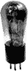
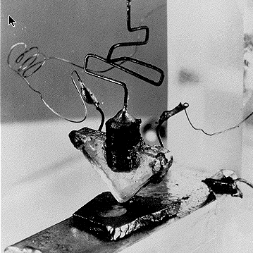
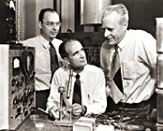
Vacuum Tube Replacement
1947
John Walter William
Bardeen Brattain Shockley
1908-1991 1902-1987 1910-1989
Solid State Amplifier
Noble Prize 1956

Slide 26
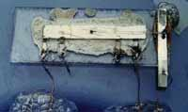
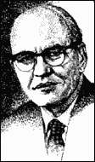
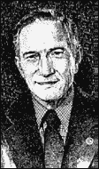
Integrated Circuits
1958
Jack Kilby
TI
Robert Noyce,
Intel
1923-2005
1928-1990
Noble Prize 2000
Noyce Founded Intel
Ted Hoff worked for Noyce

Slide 27
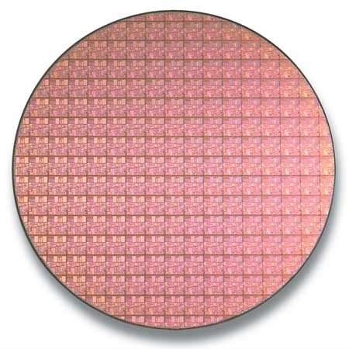
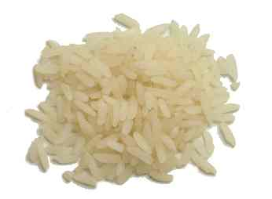
The world manufactures more transistors than it grows grains of rice.
Wow!
0.13-micron, Intel Pentium 4
300-mm silicon wafer.
Long Grain Jasmine Rice

Slide 28
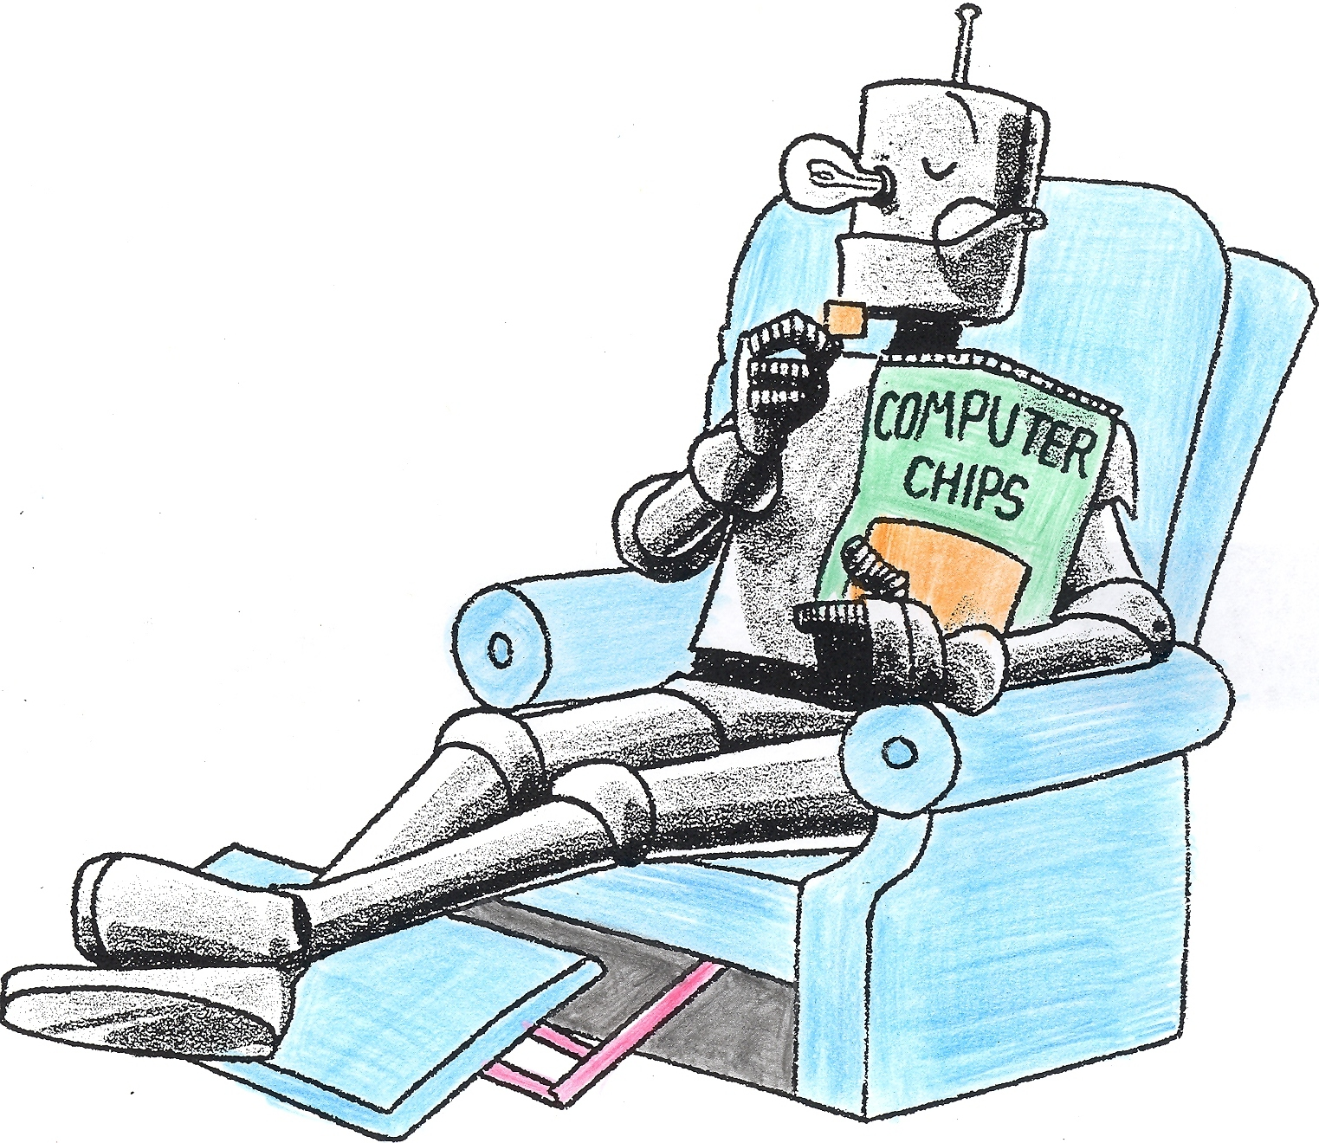
It’s all done with Computer Chips

Slide 29
Evolution: Chapters 3 and 4
Regenerative Receiver
Tuned RF Receiver

Slide 30
Evolution: Chapters 5 and 6
Heterodyne Receiver
Please send along a Carrier
so I can Demodulate
Quadrature
Down Conversion
Two Analog Paths
Suppressed Carrier
Receiver
Phase Locked Loop
(PLL)
Never Mind, I’ll make my Own!

Slide 31

Poor Designs in Past Radios
Ignoring Analog Path Imbalance
Cosine Tapered Nyquist Pulses
Reduced Excess BW in Shaping Filters
Gaussian Shaped Windows and Filters
Scaling Filter Coefficients to Obtain Unity Pass-band Gain
Sliding Window Spectrum Analysis with less Than 75% Overlap
Big Signal Capture of AGC in Spectrum Analyzers
Chebyshev Stopband Amplitude Sidelobes
Not Scaling Signal Samples with SNR
Cooley-Tukey FFT Instead of Good-Thomas FFT

Slide 32
I-Q Gain and Phase Imbalance
I-Q Gain and Phase Imbalance Responsible for Linear I-Q Coupling (Breaks Orthogonality)
And Non-Linear Coupling of Positive and Negative Frequency Components (Breaks Orthogonality)
Balanced
Imbalanced
Conventional I-Q Down Conversion
Matching Dual I-Q Up Conversion
Gain
Imbalance
Phase
Imbalance

Slide 33
I-Q Imbalance Requires DC Cancellers Then Phase Correction and Gain Correction
Model
DC- Cancelers
Phase Correction
Gain Correction
I-&-Q
Not Orthogonal

Slide 34
4096 Constellation Points in Back Haul OFDM Modem
ADC Noise from 12-Bit ADC

Slide 35
4096 Constellation Points in Back Haul OFDM Modem
ADC Noise from 10-Bit ADC

Slide 36
DC Component in OFDM due to ADC Bias
DC From (Null)
Empty FFT Bins
Quantizing Noise in (Null)
Empty FFT Bins
DC From
Occupied FFT Bins

Slide 37
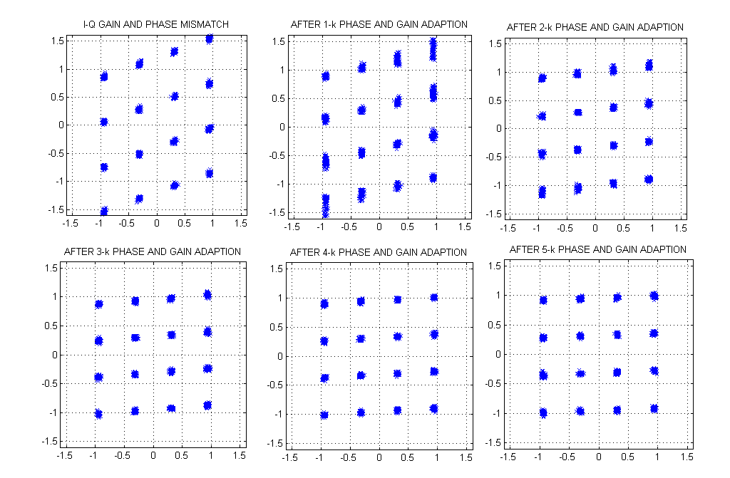
Sequence of 16-QAM Constellations During Phase and Gain Balancing
I not Orthogonal to Q
Range of Q Larger than
Range of I

Slide 38
Analog Block Conversion
Desired Signal
Crosstalk from I-to-Q
Crosstalk –freq to +freq

Slide 39
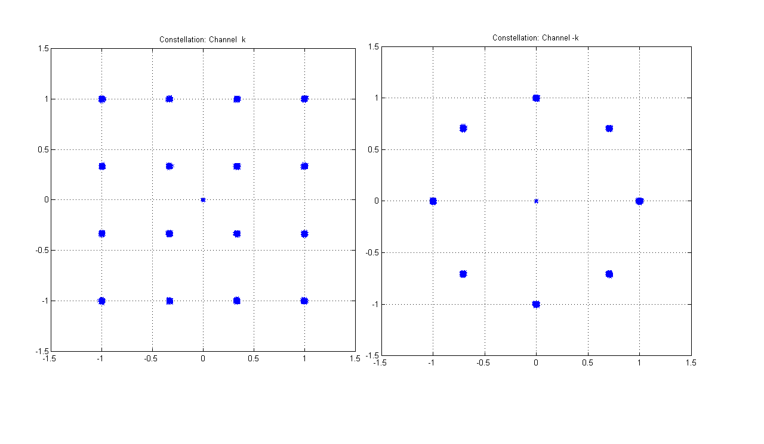
Constellations of channel +k and -k

Slide 40
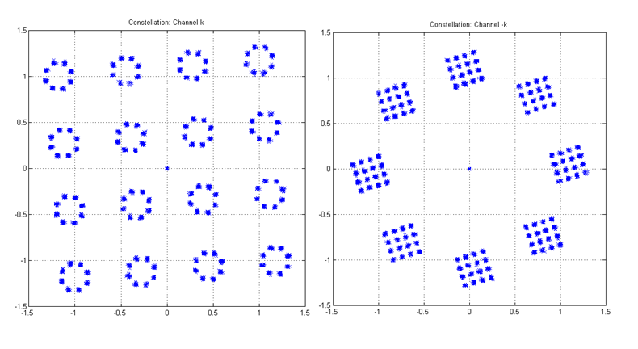
Crosstalk Between Channels k and –k Due to Mixer Gain and Phase Imbalance

Slide 41
Adaptive Image Canceller
Some of Signal B Uninvitedly Resides in Signal A
Canceller Estimates how much of B is in A
and Subtracts it out
-
Cross Correlate
Complex Baseband
A and B Signals
-
Some of Signal A Uninvitedly Resides in Signal B
Canceller Estimates how much of A is in B
and Subtracts it out

Slide 42
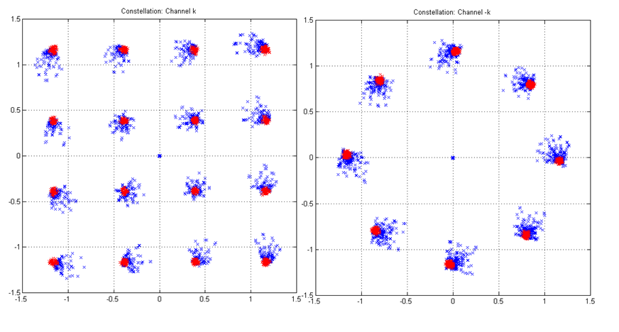
Crosstalk Between Channels k and –k Suppressed by Adaptive Canceller

Slide 43
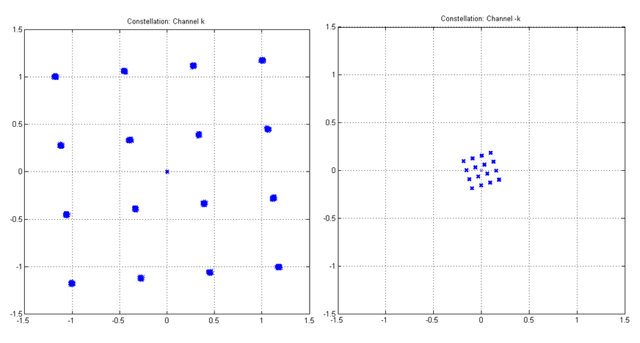
Crosstalk Between Occupied Channel k and Empty Channel -k

Slide 44
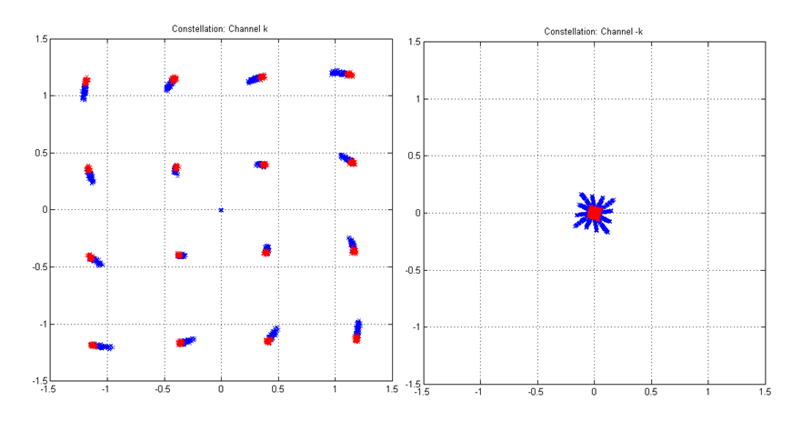
Constellation after Gradient Descent Suppression of Gain and Phase Imbalance

Slide 45
Start of the Modern era Digital Modulation, ADC and DSP Insertion
Two Analog Paths
Oh no! Another Oscillator (Sampling Clock)!

Slide 46
Non Linear Effect of Filter Imbalance
46

Slide 47
1% Change in Analog Filter Bandwidths in I and Q Paths
[bb1, aa1] = cheby1(5, 0.1, 20.2/50);
[bb2, aa2] = cheby1(5, 0.1, 20.0/50);
0.1 dB ≈1.1 %
err <0.4%
-25 dB Spectral Image
47

Slide 48
Spectrum of OFDM Input Signal Set:
Every 4-th Bin in Positive Frequencies Occupied, All Bins in Negative Frequencies Empty
At Output, All Occupied Negative Frequency Bins are Due to Filter Imbalance
Empty at Input
Filter Difference
Images at Output
Filter Sum at Output
48

Slide 49
Filter Difference Images Crossover Between Positive and Negative Frequencies
Limits Dynamic Range (Constellation Density) of OFDM Signaling
49

Slide 50
Sample the Intermediate Frequency Stage To Avoid Effects of Analog Filter Tolerances and Imbalances
DSP
Down Convert
Only One Analog Path

Slide 51
Perform Timing and Carrier Synchronization in DSP Land

Slide 52
RECOMMENDATION
For High Performance Radios
Avoid Analog I-Q Up Conversion and
Avoid Analog I-Q Down Conversion
If you can’t Avoid it be prepared to
Remove Effects by Probe Preambles and
Adaptive Cancelling of Dirty RF Components

Slide 53
Poor Designs in Past Radios
Ignoring Analog path Imbalance
Cosine Tapered Nyquist Pulses
Reduced Excess BW in Shaping Filters
Gaussian Shaped Windows and Filters
Scaling Filter Coefficients to Obtain Unity Pass-band Gain
Sliding Window Spectrum Analysis with less Than 75% Overlap
Big Signal Capture of AGC in Spectrum Analyzers
Chebyshev Stopband Amplitude Sidelobes
Not Scaling Signal Samples with SNR
Cooley-Tukey FFT Instead of Good-Thomas FFT
53

Slide 54
A Communication System
Shaping Filter
Limits Signal BW
Matched Filter
Reduces Noise BW

Slide 55
Communication over Bandwidth Limited, AWGN Channel
H₁(ω)
H₂(ω)
H_{d}(w)
H₂(ω) = H₁*(ω) e ^{jωτ}
(Maximize SNR)
H_{d}(ω) = H₁(ω) H₁*(ω) e ^{jωτ} = |H₁(ω)|² e ^{jωτ}
|H₁(ω)|² e ^{jωτ} = H_{NYQ}(ω) e ^{jωt}
(Zero ISI)
55
H₁(ω) = SQRT{H_{NYQ}(ω)}

Slide 56
Bandwidth Limited Channel Zero ISI and Causal Response
Nyquist Spectrum
With Excess BW Taper
Nyquist Spectrum
Excess BW
For Finite Duration
Filter
Infinite Duration
Nyquist Pulse
Finite Duration
Nyquist Pulse
56

Slide 57
Develop the SQRT Nyquist Filter
Equally Spaced Zero Crossings
Nyquist made a mistake
right here!
Half Cycle of Cosine
Need to do SQRT Here
While Spectrum is Positive.
Then Limit Time Duration
With Rectangle Window.
57
Notes:
What is the project about?
Define the goal of this project
Is it similar to projects in the past or is it a new effort?
Define the scope of this project
Is it an independent project or is it related to other projects?
* Note that this slide is not necessary for weekly status meetings

Slide 58
Square-Root Spectrum, Truncate Time Series, Examine Spectrum
Discontinuous
First
Derivative
Side Lobe
Decay Rate
(1/t²)
Pass-Band
Ripple
Stop Band
Ripple
Pass-Band Ripple
Stop-Band
Ripple
58

Slide 59
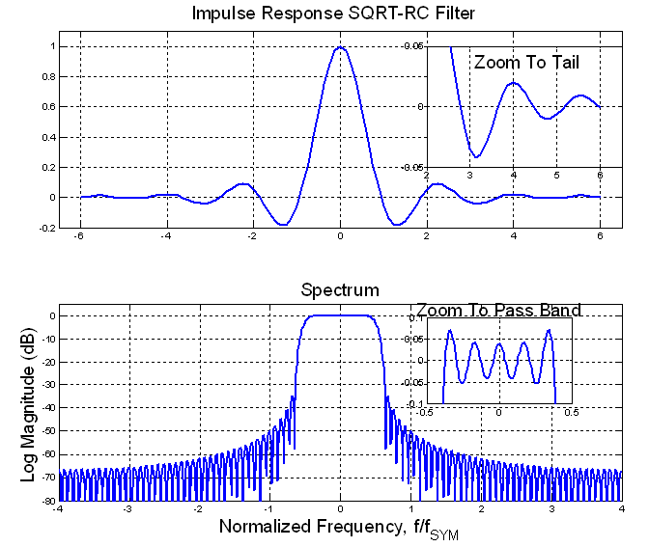
SQRT-RC (SQRT Cos-Taper) Impulse Response Rectangle Windowed to Finite Duration
Discontinuous
Derivative
-35 dB
(0.0178)
0.08 dB
(0.009)
60

Slide 60
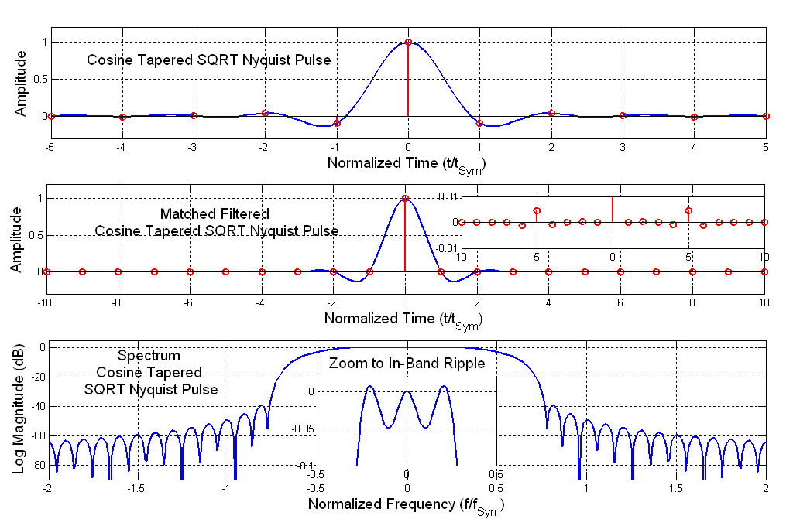
Cosine Tapered Nyquist Pulse and Correlation, Matched Filter Response
10-Symbol Length SQRT
Nyquist Taper
Pre and Post
Echoes Due to
In-Band Ripple
High In-band
And Stop-band
Sidelobe Levels
63

Slide 61
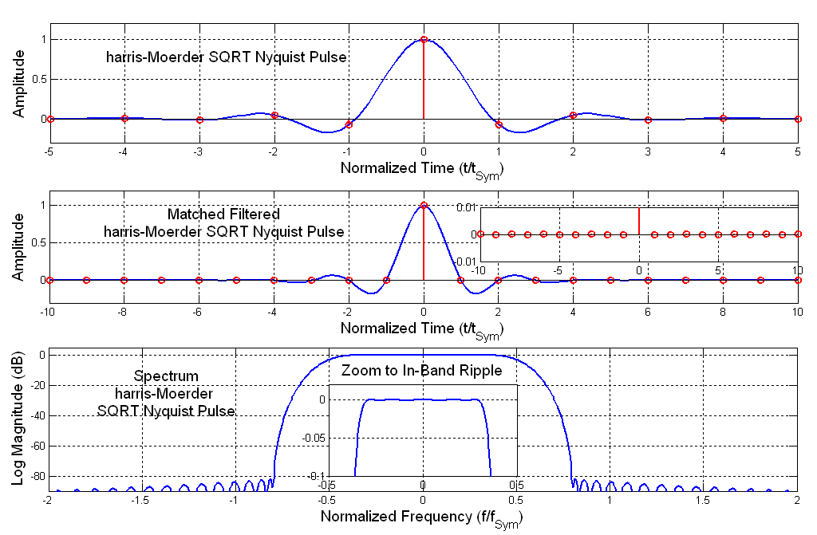
harris-Moerder Nyquist Pulse
10-Symbol
Length SQRT
harris-Moerder
Taper
Negligible
Pre and Post
Echoes Due to
In-Band Ripple
Very Low
In-band and
Stop-band
Sidelobe Levels
64

Slide 62
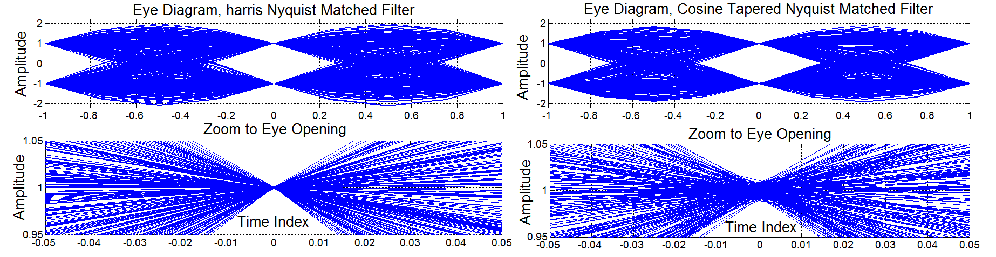
Eye Diagrams and Zoom, Cosine and harris Tapered SQRT Nyquist Shaped and Matched Filtered Time Series
65

Slide 63
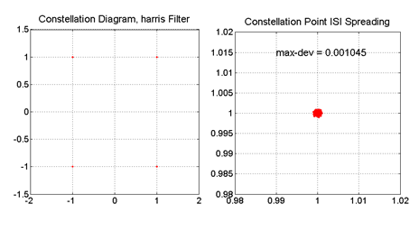
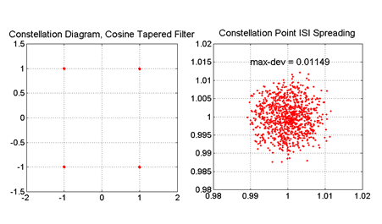
Constellations and Zoom to ISI Spreading: harris & Cosine Tapered SQRT Nyquist Shaped and Matched Filtered Series
Spreading Caused by in-Band Ripple
of Shaping and Matched Filters.
This is measured as Error Vector
Magnitude (EVM) by Vector Signal
Analyzer (VSA) Which measures
spreading due to signal degradation
from all processing sources.
Reasonable EVM levels are
1% Peak and 0.33% RMS.
The spreading in the figure to
the left is slightly worse than
this. The figure above is an order
of magnitude better than this.
66

Slide 64
RECOMMENDATION
For High Performance Radios
Avoid Cosine Taper SQRT Nyquist Shaping Filters
Consider Use of
Harris-Moerder or Harris Taper SQRT Nyquist Shaping Filters
We know how to do it correctly, why don’t we?
Because the bad specs are in the standards!

Slide 65
Bad Implementation Decisions
Ignoring Analog path Imbalance
Cosine Tapered Nyquist Pulses
Reduced Excess BW in Shaping Filters
Gaussian Shaped Windows and Filters
Scaling Filter Coefficients to Obtain Unity Pass-band Gain
Sliding Window Spectrum Analysis with less Than 75% Overlap
Big Signal Capture of AGC in Spectrum Analyzers
Chebyshev Stopband Amplitude Sidelobes
Not Scaling Signal Samples with SNR
Cooley-Tukey FFT Instead of Good-Thomas FFT
67

Slide 66
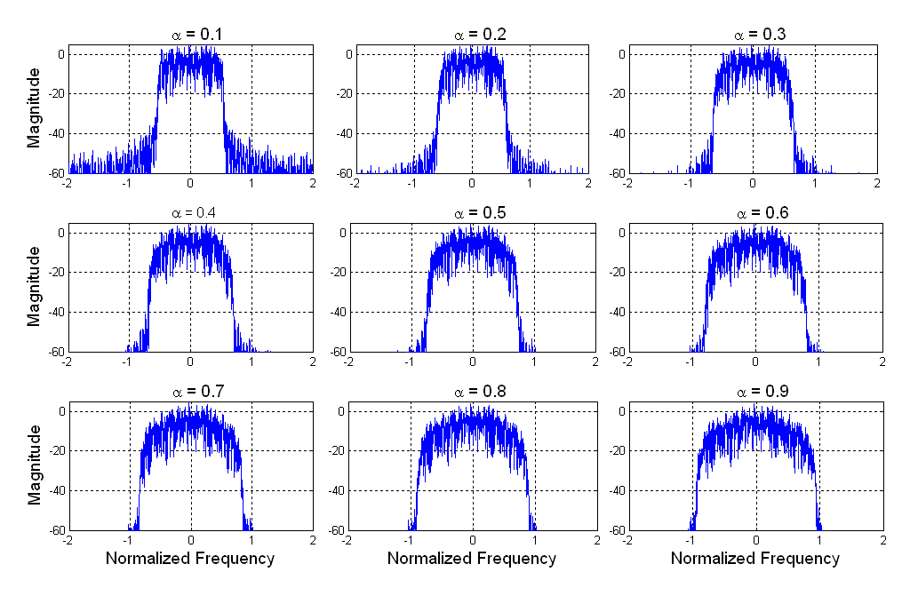
Spectra of Modulated Waveform for α = 0.1, 0.2,…, 0.9
68

Slide 67
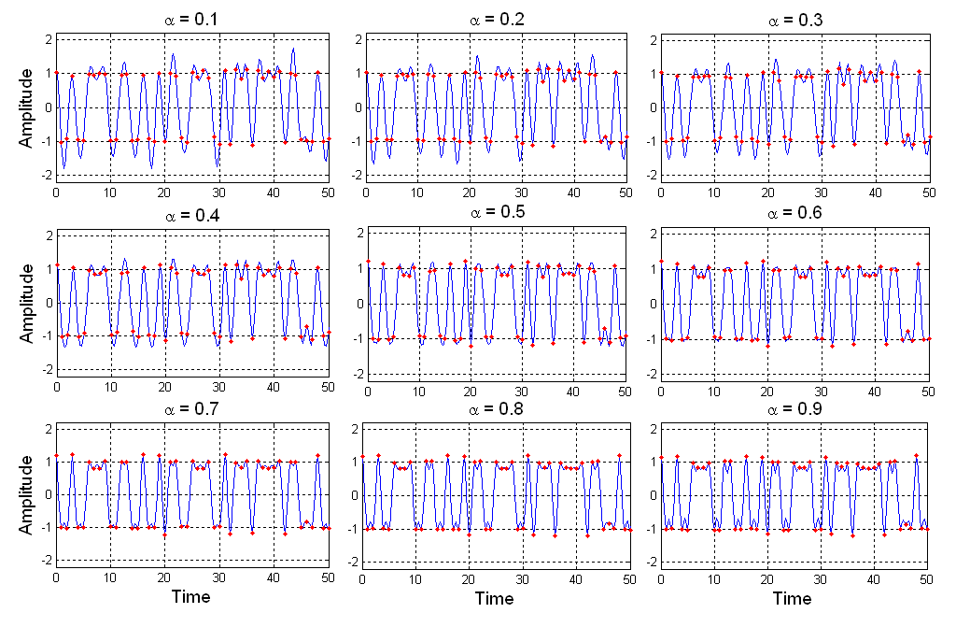
Real Part Modulation Time Series, QPSK for α = 0.1, 0.2,…, 0.9
Reduced Excess BW
Requires Longer Shaping
Filters. Longer Shaping
Filter have more coefficients
Which results in larger
Values of Peak Signals,
Larger Peaks Amplitudes
Increases Peak to Average
Power Ratio (PAPR).
We respond to larger signals
by reducing drive amplitude
to output power stage.
Reduced output power
means reduced transmitter
Range.
69

Slide 68
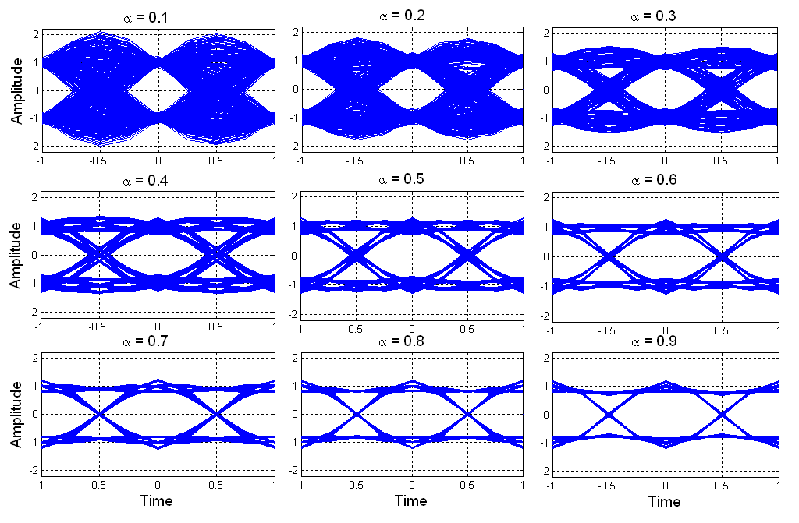
Eye Diagrams QPSK Modulation for α = 0.1, 0.2,…,0.9
Reduced Excess BW
Longer Shaping Filters
More Memory In
Shaping Filter, Higher
Peak to Average Power Ratio (PAPR). Must Reduce Signal Level to Avoid Saturating Power Amplifier: Less Range,
Poorer Amplifier Efficiency
70

Slide 69
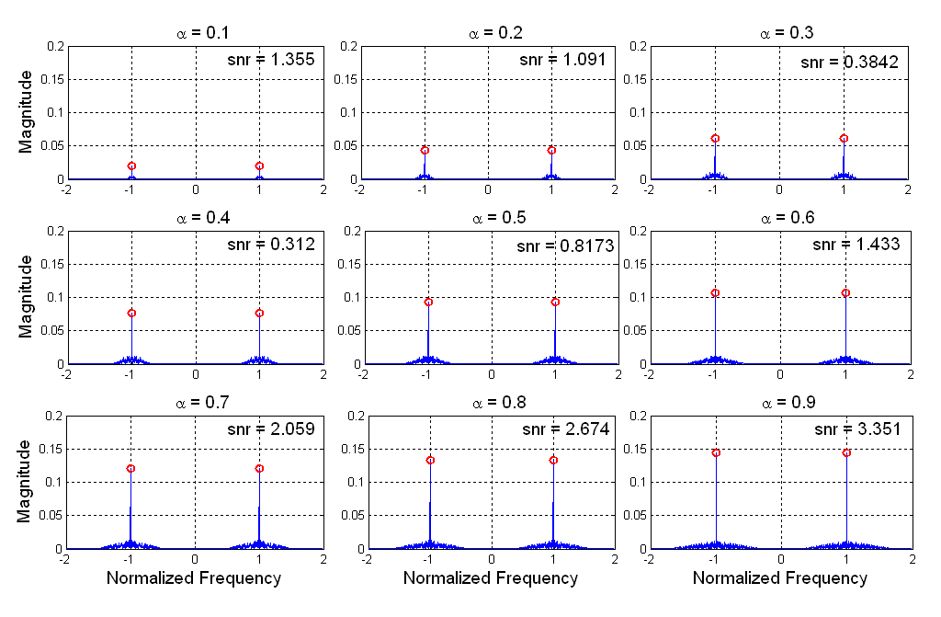
Cyclostationary Clock Line Spectra Extracted from Modulated Waveform for α = 0.1, 0.2,…, 0.9
Reduced Excess BW
Less Energy in
Transition Bandwidth
Less energy in
Timing Lines
Harvested from Band
Edge, Cyclo-Stationary
Signal. Timing Recovery
Loop has to Work
Harder to Synch.
71

Slide 70
RECOMMENDATION
For High Performance Radios
Avoid Selecting Small Excess Bandwidth in SQRT Nyquist Shaping Filters
Packing Spectra closer may not be a good trade in reduced range and poorer
Power amplifier Efficiency

Slide 71
Poor Designs in Past Radios
Ignoring Analog path Imbalance
Cosine Tapered Nyquist Pulses
Reduced Excess BW in Shaping Filters
Gaussian Shaped Windows and Filters
Scaling Filter Coefficients to Obtain Unity Pass-band Gain
Sliding Window Spectrum Analysis with less Than 75% Overlap
Big Signal Capture of AGC in Spectrum Analyzers
Chebyshev Stopband Amplitude Sidelobes
Not Scaling Signal Samples with SNR
Cooley-Tukey FFT Instead of Good-Thomas FFT
72

Slide 72
Average
Time Duration
Average
Band Width
Inverse Fourier Transform
Forward Fourier Transform
Signal Energy
Time Center
Frequency Center
Moments ignore specific shapes, are easy to compute and are easy to compare

Slide 73
Uncertainty Principal
A Signal can not be Narrow in both Time and Frequency Domains
If it is Narrow in one Domain, it is Wide in the Other
SQRT Second Central Moment in Time
SQRT Second Central Moment in Frequency
Time-Bandwidth Product
Signal with Smallest Time-Bandwidth Product is the Gaussian Function
With Time-Bandwidth Product = 0.5
Minimum-Time-Bandwidth Product
Common Wisdom: Since Gaussian has minimum T-BW product it is
Optimum for Time-Frequency Localization (Wrong!!)

Slide 74
What is Wrong with this Conclusion?
What is wrong, is that any collected signals on which we perform signal processing must
have a finite support. Consequently any window we apply to a time signal must also have a
finite support. This means when we apply a Gaussian Window to signal we must truncate the
edges of the window. When we truncate the Gaussian window, its spectrum grows sidelobes,
and it is no longer the function with minimum Time-Bandwidth product. That label resides
with the answer to this question: What function on a finite support has the minimum Time-
Bandwidth product? It is the Prolate-Spheroid Function or its very close cousin, the Kaiser-
Bessel Window, or its close second cousin, the 1/f sidelobe Remez Window.
Signal processing folks often mistakenly use the truncated Gaussian window unaware of the
effect of truncation that is avoided by design in the Kaiser window.

Slide 75
Change σ of Gaussian window to control size of
discontinuity at edge boundaries. Step size
controls maximum spectral sidelobe. Here
σ was adjusted for -60 dB maximum
sidelobe.
Main Lobe Width
3.6 Bins

Slide 76
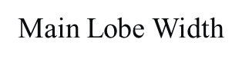
Change β of Kaiser-Bessel window to control
size of discontinuity at edge boundaries. Step
size controls maximum spectral sidelobe.
Here β was adjusted for -60 dB
maximum sidelobe.
2.8 Bins

Slide 77
Change Δf, transition BW, of 1/f stopband Remez
Algorithm to control discontinuity step size
at edge boundaries. Step size controls
maximum spectral sidelobe. Here
Δf adjusted for -60 dB
maximum sidelobe.
2.5 Bins

Slide 80
Compare Time Windows of Gaussian
And Optimum T-BW Windows that
Have -100 dB Maximum Sidelobe Levels
Compare Spectral Main Lobe
Bandwidths of Gaussian Window
And Optimum T-BW Windows that
Have -100 dB Maximum Sidelobe Levels

Slide 81
Spectrum of Gaussian Window Resolving Position and Amplitude of two tones Separated by 6-bins with amplitude ratio 1-to-0.0001
A1= 1, f1=10
A2= 0.0001, f2=16
Spectrum of 1/f Stopband Remez Window Resolving
Position and Amplitude of two tones Separated by
6-bins with amplitude ratio 1-to-0.0001
A1= 1, f1=10
A2= 0.0001, f2=16

Slide 82
RECOMMENDATION
For High Performance Radios
Never Use a Gaussian Window to Obtain Time Frequency Localization
Consider Use of
Kaiser-Bessel, or Prolate Spheroid, or 1/f Stopband Taper Remez Window
No Contest!

Slide 83
Poor Designs in Past Radios
Ignoring Analog path Imbalance
Cosine Tapered Nyquist Pulses
Reduced Excess BW in Shaping Filters
Gaussian Shaped Windows and Filters
Scaling Filter Coefficients to Obtain Unity Pass-band Gain
Sliding Window Spectrum Analysis with less Than 75% Overlap
Big Signal Capture of AGC in Spectrum Analyzers
Chebyshev Stopband Amplitude Sidelobes
Not Scaling Signal Samples with SNR
Cooley-Tukey FFT Instead of Good-Thomas FFT

Slide 84
Digital Filters Grow Pass Band Gain in Proportion to Bandwidth Reduction
100-Tap Box-car Integrator

Slide 85
Where to Scale Processing Gain?
Need Scale Factor to attenuate
Processing Gain resulting
from BW reduction!
Where can we insert
the Scale Factor?
MAJOR RULE:
Never Scale to cancel Processing Gain
at input to an algorithm!
Unscale filter coefficients, Let growth occur and
scale filter output
Foolish to
Discard Input
Data Bits
Filter Designer Foolishly
Discards Input
Coefficient Bits

Slide 86
Arithmetic SNR Improvement Re-scale Coefficients in Digital Filter
Rescale
SNR
Coefficient Bits
With Leading Zeros
Due to Applied Scaling
SNR
Coefficient Bits
No Leading Zeros

